Slide 1
Analysis of countries needing Aid from the NGO
-Md. Ismail Khan
-7677484146
-Cu.17bcs3310@gmail.com

Slide 2
Problem Statement
There is an international NGO, committed to fighting poverty and providing the people of backward countries with basic amenities and relief at times of disaster
The CEO of this NGO needs to decide how to use his funding strategically and effectively
Solution:-
We as a Data Scientist help the NGO to provide with the countries with most need of Aid.

Slide 3
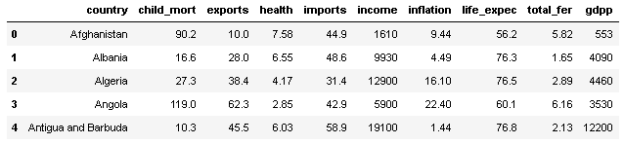
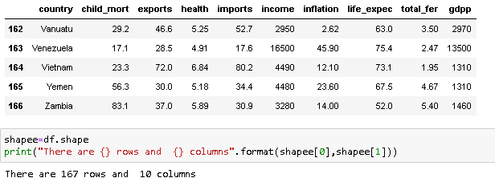
Data of the countries!

Slide 4
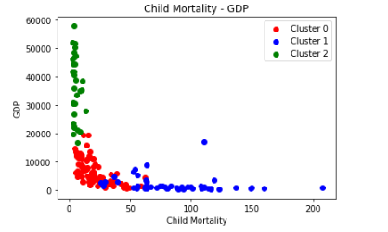
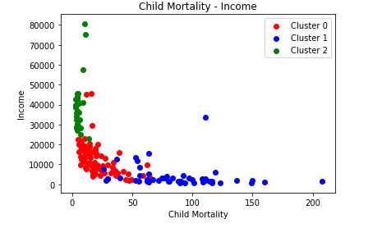
KMeans Clustering
As we can interpret from both of the scatter plot :-
Lower the GDP of the Country Higher is the Child Mortality
Lower the Income of the Country Higher is the Child Mortality
So we know countries with lower GDP & Income need more Aid

Slide 5
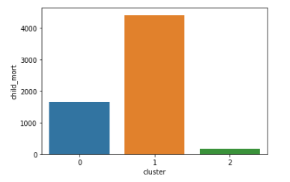
There are 51 countries which needs most attention by the NGO They are as follows-
Afghanistan
Angola
Benin
Botswana
Burkina Faso
Burundi
Cameroon
Haiti
Iraq
Kenya
Kiribati
Lao
Lesotho
Liberia
Madagascar
Malawi
Mali
Mauritania
Micronesia, Fed. Sts.
Mongolia
Mozambique
Namibia
Niger
Pakistan
Rwanda
Senegal
Sierra Leone
Solomon Islands
South Africa
Sudan
Tajikistan
Tanzania
Timor-Leste
Togo
Uganda
Vanuatu
Yemen
Zambia
Chad
Comoros
Congo, Dem. Rep.
Congo, Rep.
Cote d'Ivoire
Equatorial Guinea
Eritrea
Central African Republic
Gabon
Gambia
Ghana
Guinea
Guinea-Bissau

Slide 6
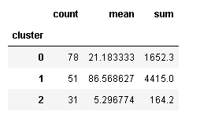
The 5 countries that are in the direst need of
aid are (Kmeans Clustering):-
Haiti
Sierra Leone
Chad
Central African Republic
Mali

Slide 7
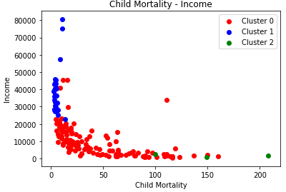
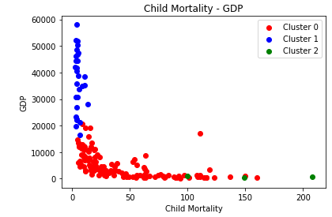
Hierarchical Clustering
As we can interpret from both of the
scatter plot :-
Lower the GDP of the Country Higher is the Child Mortality.
Lower the Income of the Country Higher is the Child Mortality.
So we know countries with lower GDP & Income need more Aid.

Slide 8
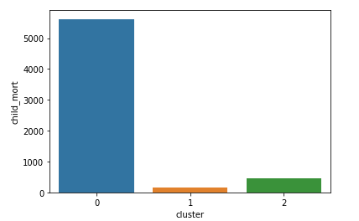
There are 127 countries which needs more attention by the NGO They are as follows-
Afghanistan
Albania
Algeria
Angola
Antigua and Barbuda
.....
….
Vanuatu
Venezuela
Vietnam
Yemen
Zambia

Slide 9
The 5 countries that are in the direst need of Aid are (Hierarchical Clustering) :-
Sierra Leone
Chad
Mali
Niger
Angola

Slide 10
Final Result
The 5 countries that are in the direst need of Aid are :-
Sierra Leone
Chad
Mali
Niger
Central African Republic

